Slide 1
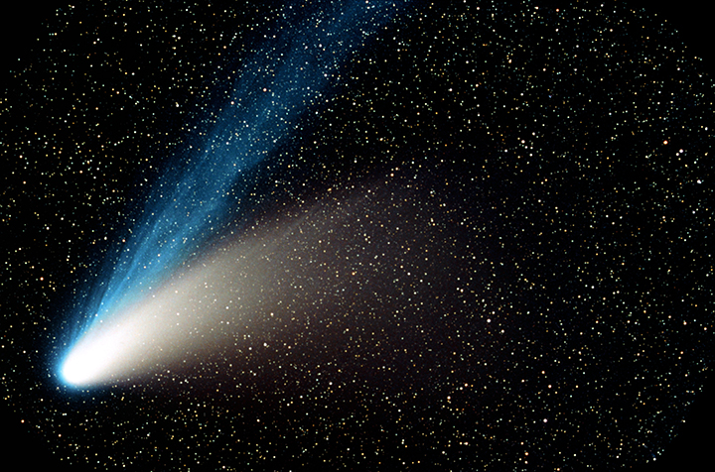
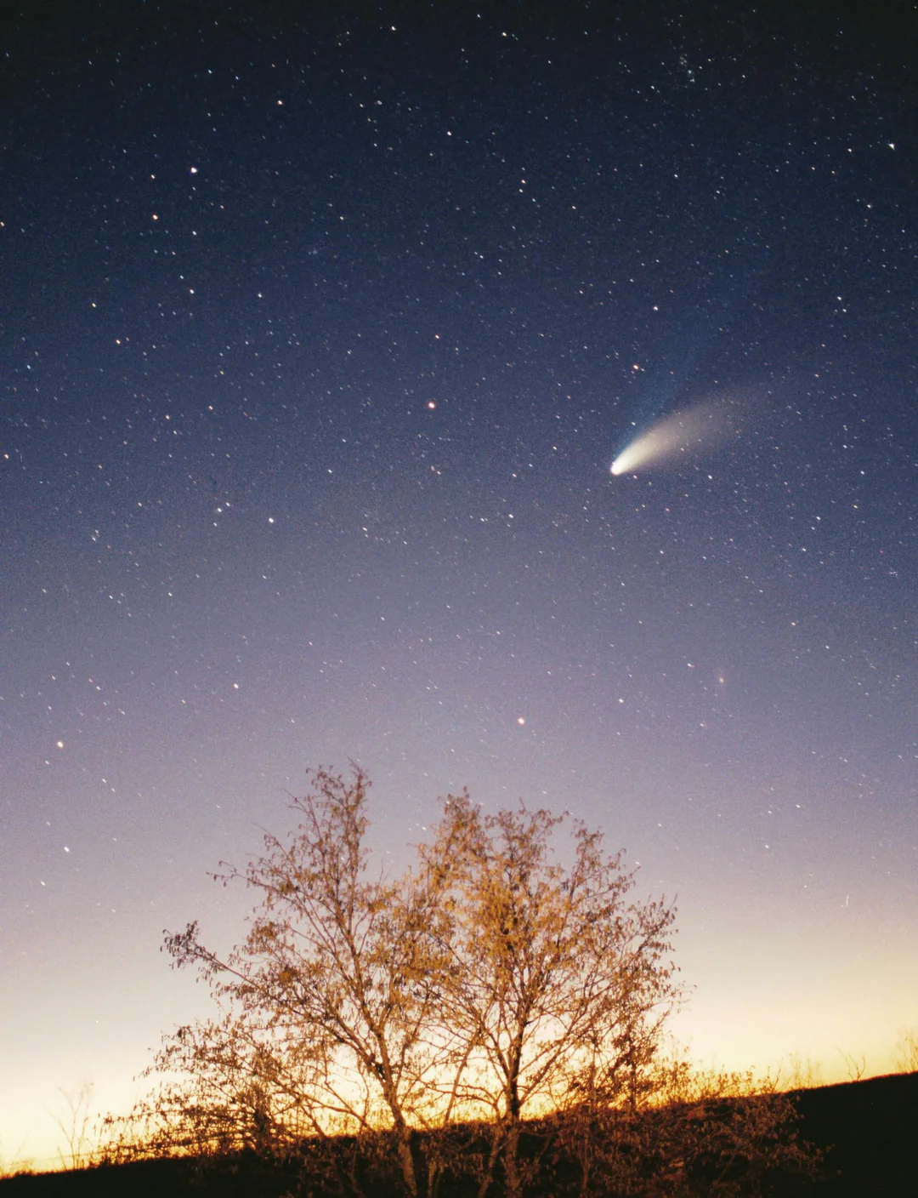
Near Earth
Comet
Simulator
Sareena Mann
Python Decal, Sp 25

Slide 2

TABLE OF CONTENTS
Defining a Near Earth comet
data used
GUI
Animation Feature
Guess orbit Feature
Demo

Slide 3

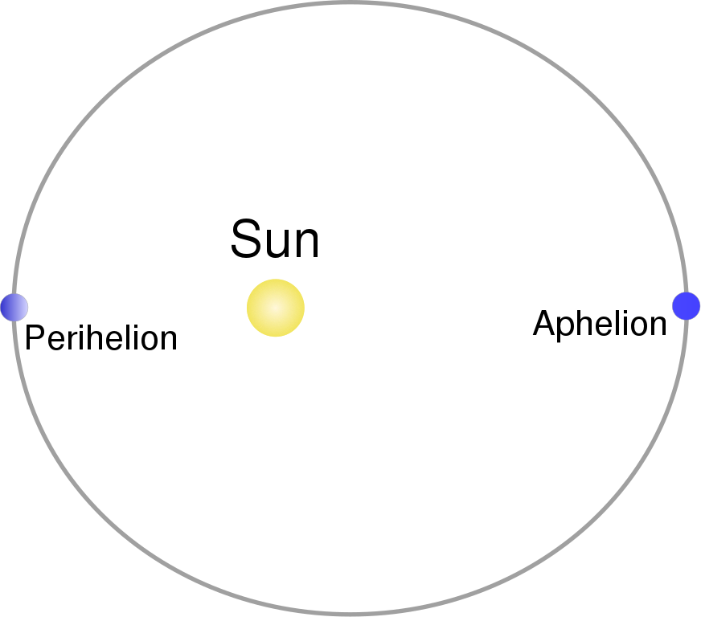
Near Earth comets
Defined as: comets with “short orbital period (less than 200 years) and perihelion distances less that 1.3 astronomical units” (UN Office of Outer Space Affairs)
1.3 AU is 130% of the average distance between the Earth and the Sun

Slide 4

Data used
NASA tracks 15,000 near Earth objects
160 of these objects are comets
Therefore, I first had to filter the data to only include comets
Notes:
https://www.kaggle.com/datasets/nasa/near-earth-comets

Slide 5


Dataset Included:
Object: the name of the object
Epoch: the epoch for the comet, in TDB
TP: time of perihelion passage, in TDB; this is the time when the comet was closest to the Sun
e: the orbital eccentricity of the comet
i: Inclination of the orbit with respect to the ecliptic plane and the equinox of J2000 (J2000-Ecliptic), in degrees
w: Argument of perihelion (J2000-Ecliptic), in degrees
Node: Longitude of the ascending node (J2000-Ecliptic), in degrees
q: comet's distance at perihelion, in AU
Q: comet's distance at aphelion, in AU
P: orbital period, in Julian years
A1: Non-gravitational force parameter A1
A2: Non-gravitational force parameter A2
A3: Non-gravitational force parameter A3
MOID (AU): Minimum orbit intersection distance (the minimum distance between the osculating orbits of the NEO and the Earth)
ref: Orbital solution reference

Slide 6
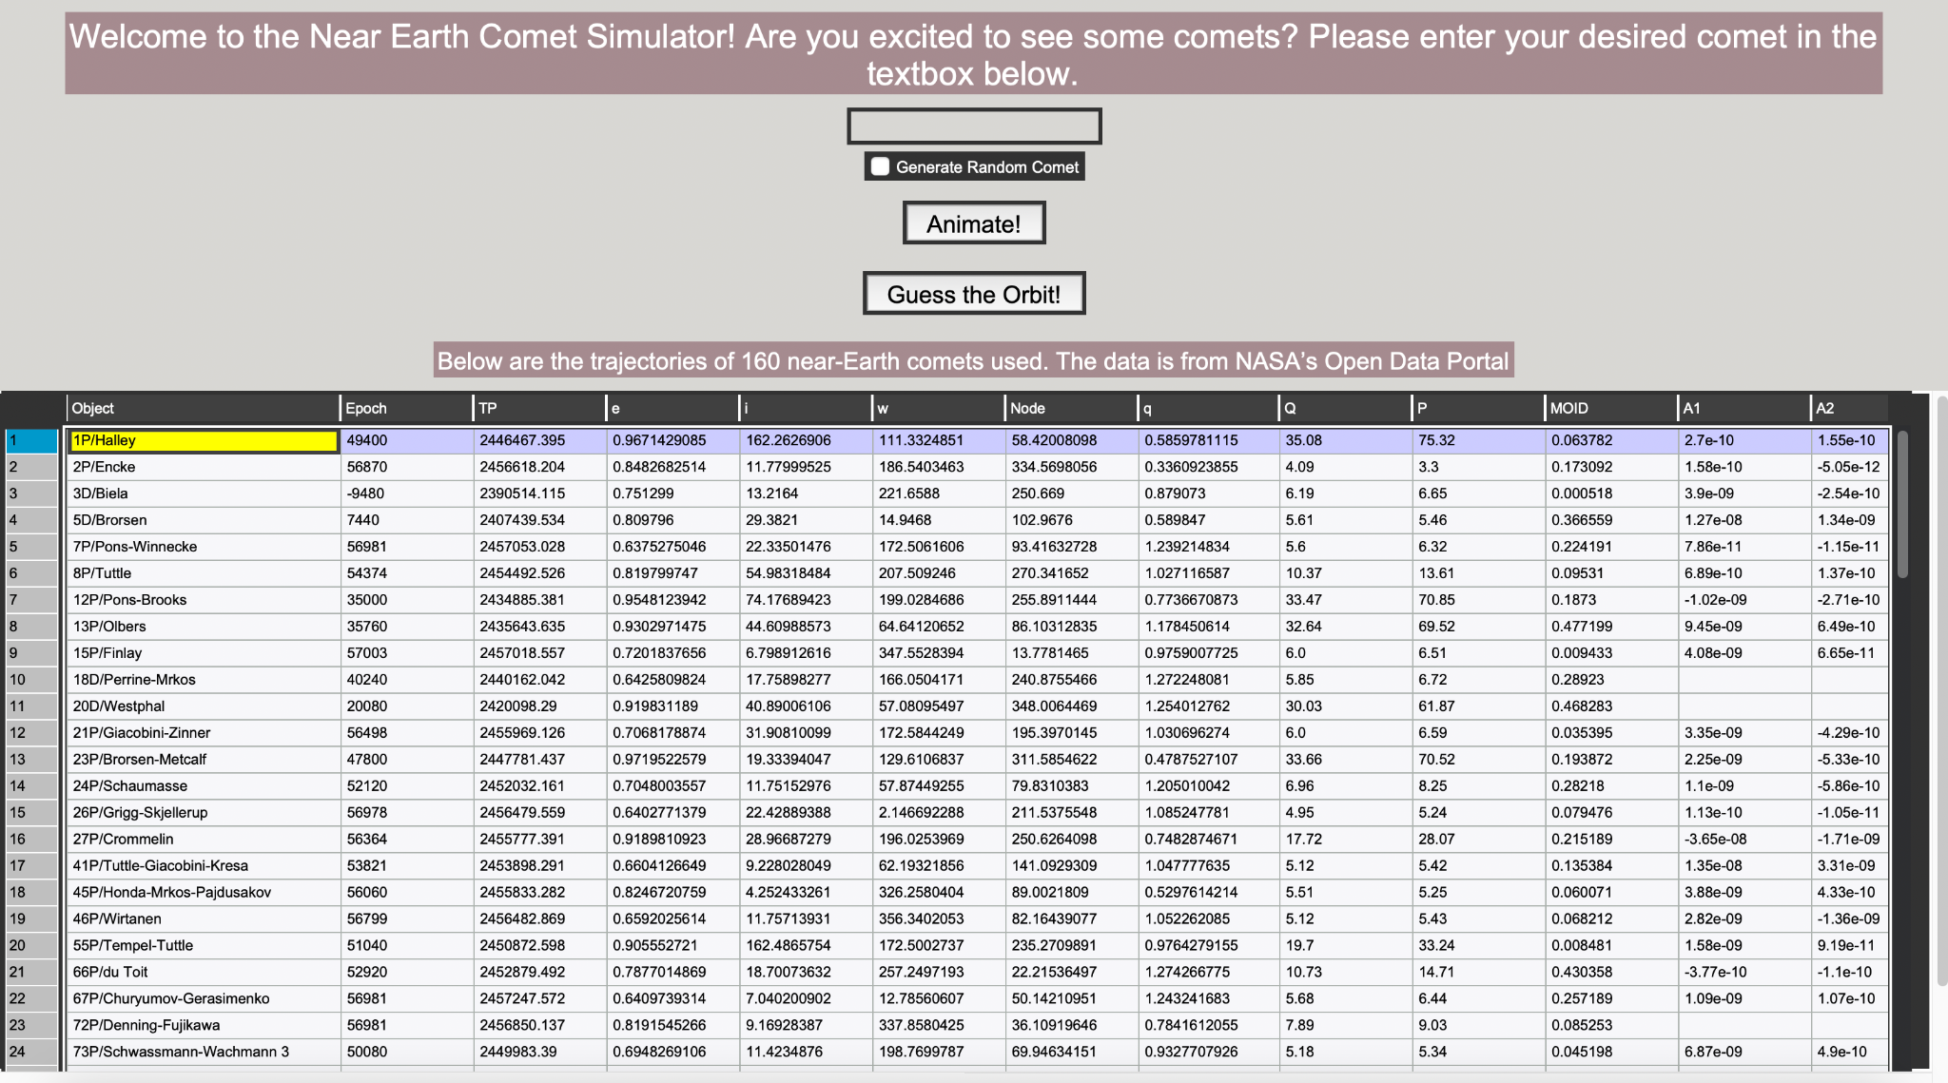
THe Gui
Tkinter (Python gui library)

Slide 7
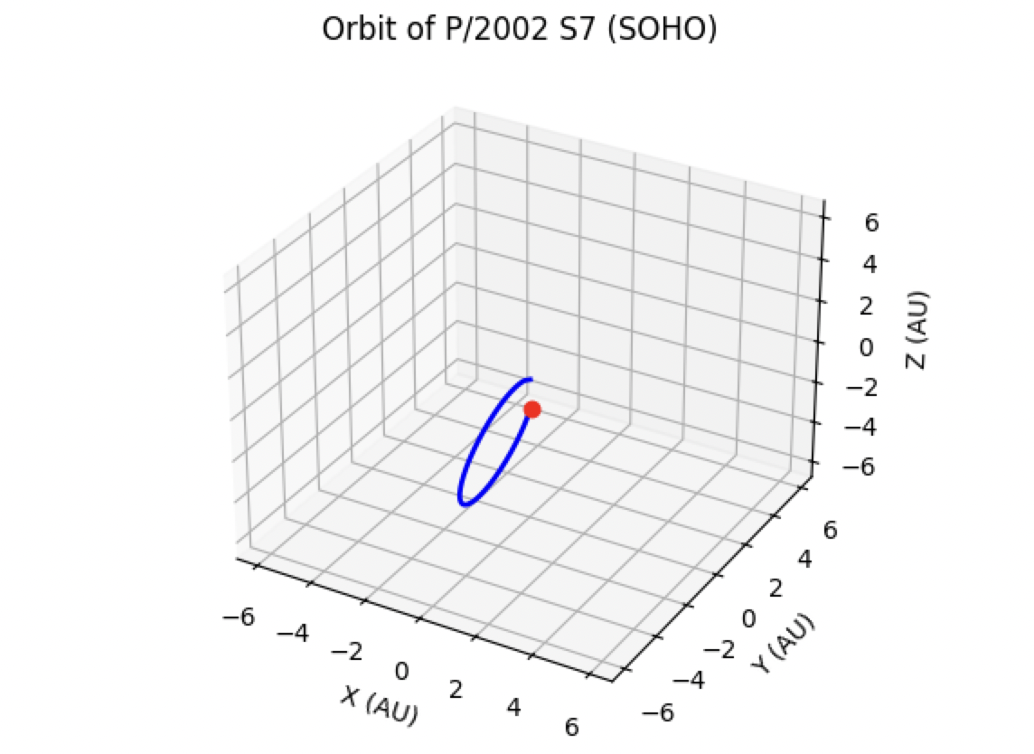
Animation Feature
Enter a comet (I render information from the data file into a scrollable table) or click “Generate Random Comet”
A pop animation of the comet’s actual
orbit will appear

Slide 8

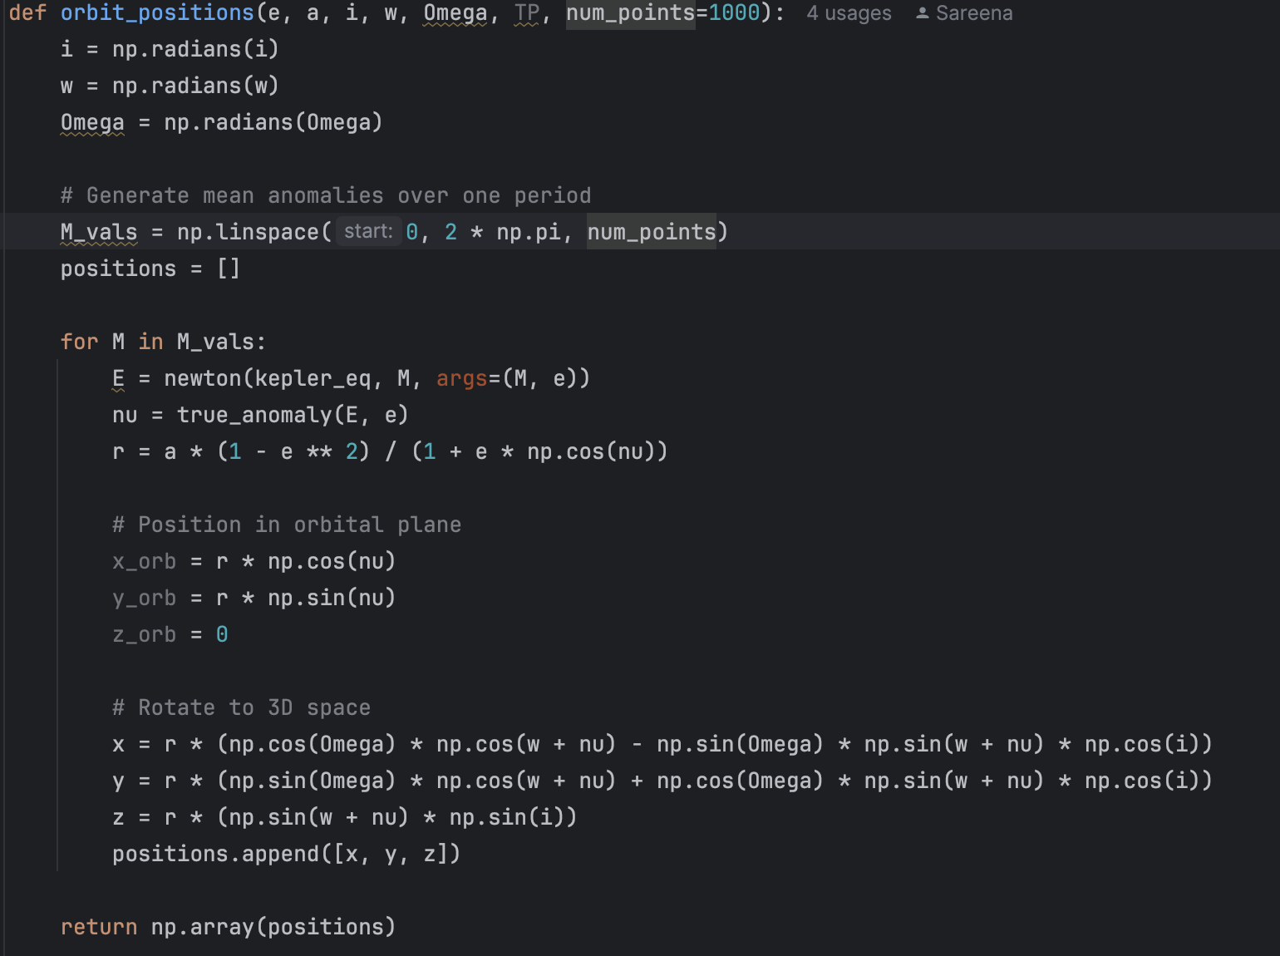
How it works
Computes comet positions using Kepler’s equation and orbital elements (eccentricity, semi-major axis, inclination, etc.)
2D:
Computed: Object’s semi major axis, mean anomaly as a function of time, eccentric anomaly, true anomaly, radial distance as a function of time
2D → 3D:
Projected 2D plane onto 3D space using the inclination and argument of perihelion (given in data)
To Animate:
Plotted points/updated frame

Slide 9
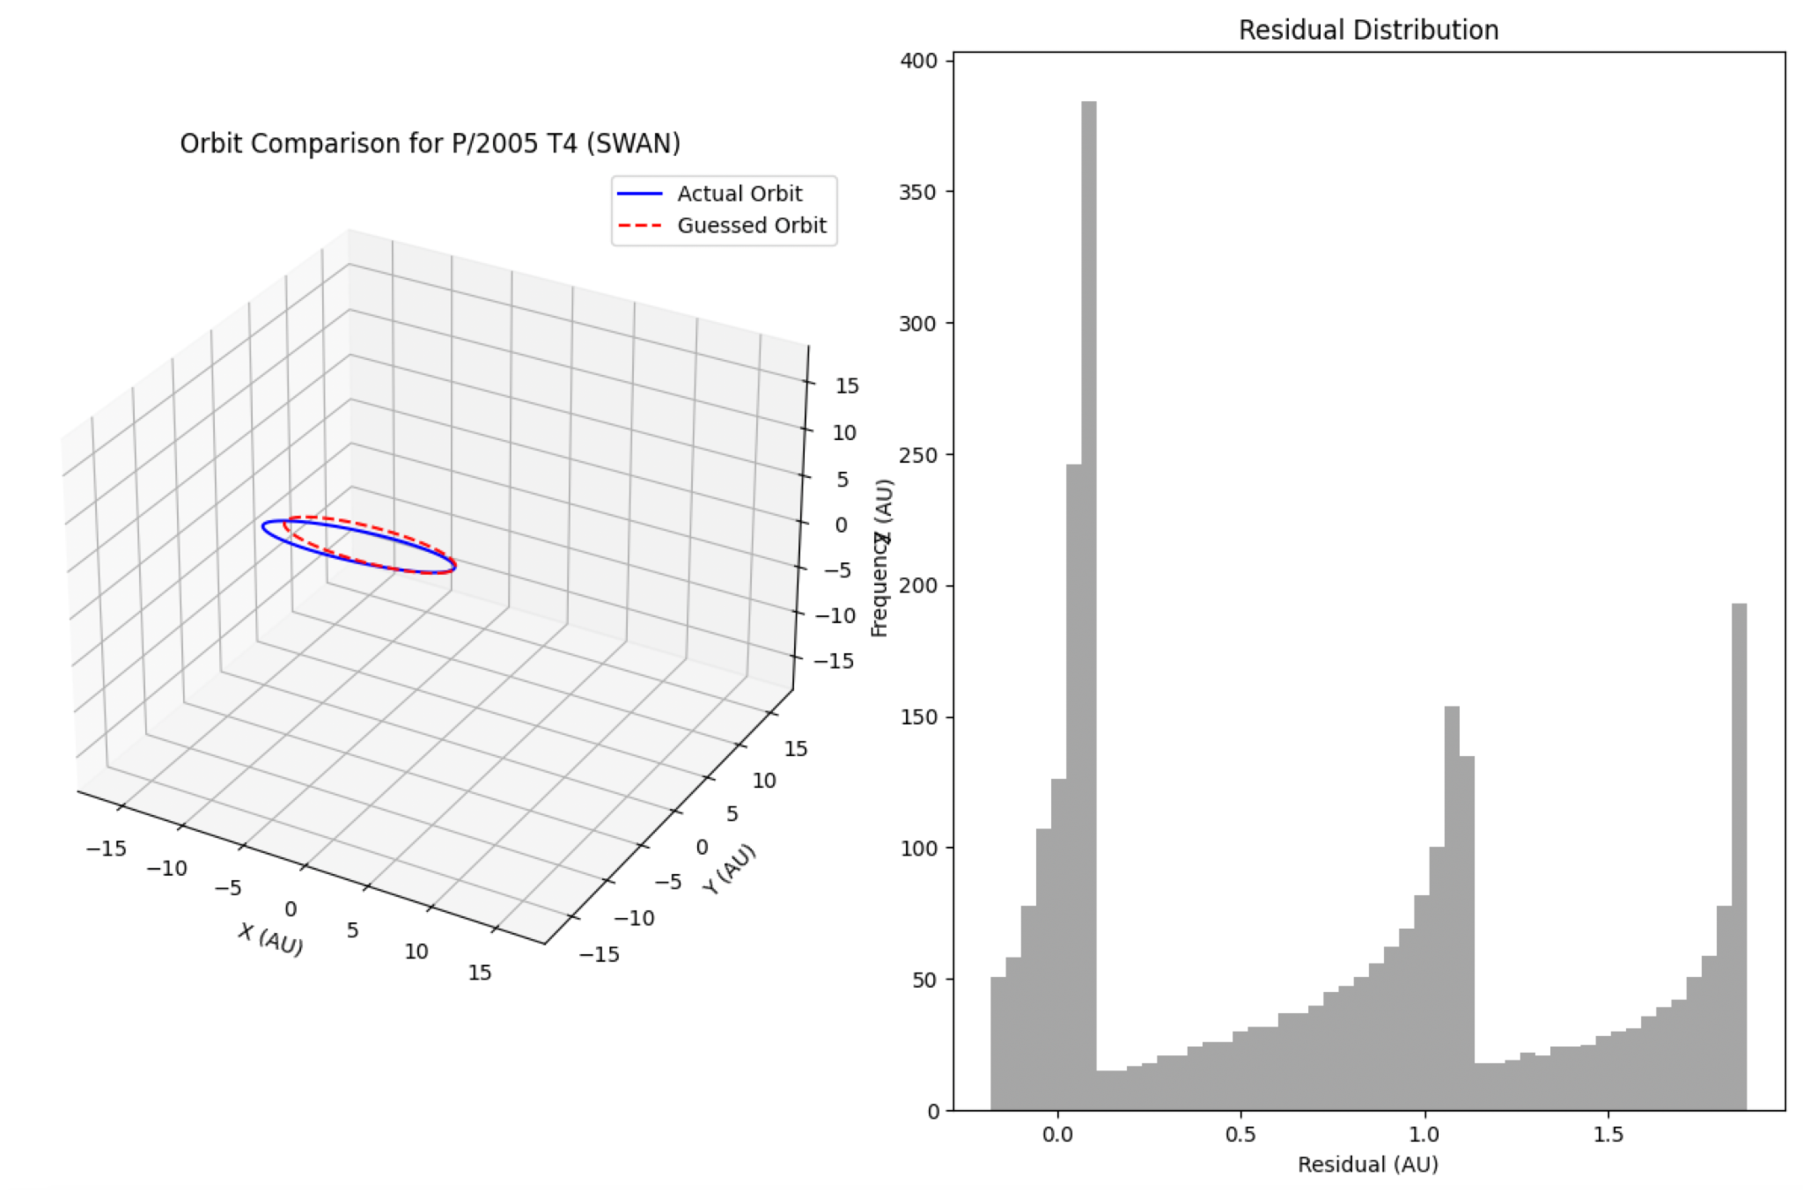
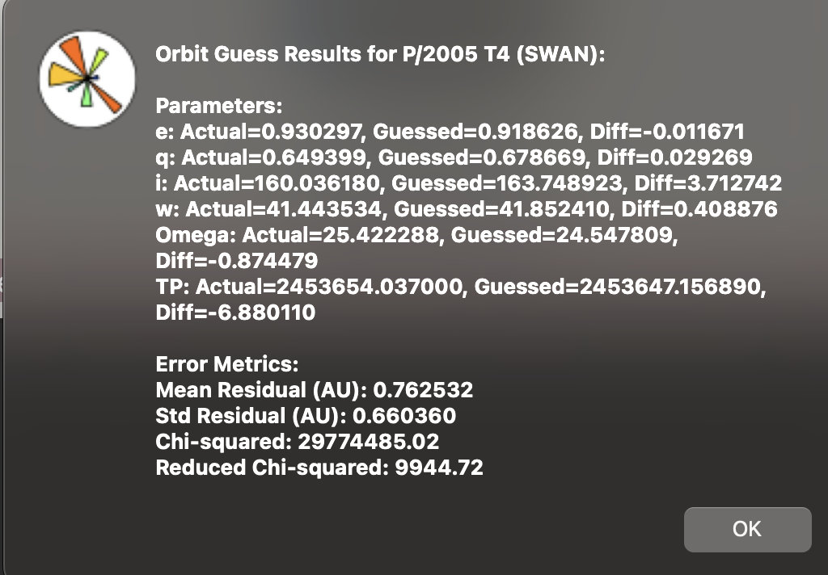
Guess orbit Feature
Enter a comet (I render information from the data file into a scrollable table) or click “Generate Random Comet”
Generates an actual orbit and a "guessed" orbit by perturbing orbital elements.
Perturbs elements randomly (e.g., e_guess = e * (1 ± random)), ensuring valid values (e.g., e < 1, q > 0.01).
Then compares the actual & Guessed Orbits

Slide 10
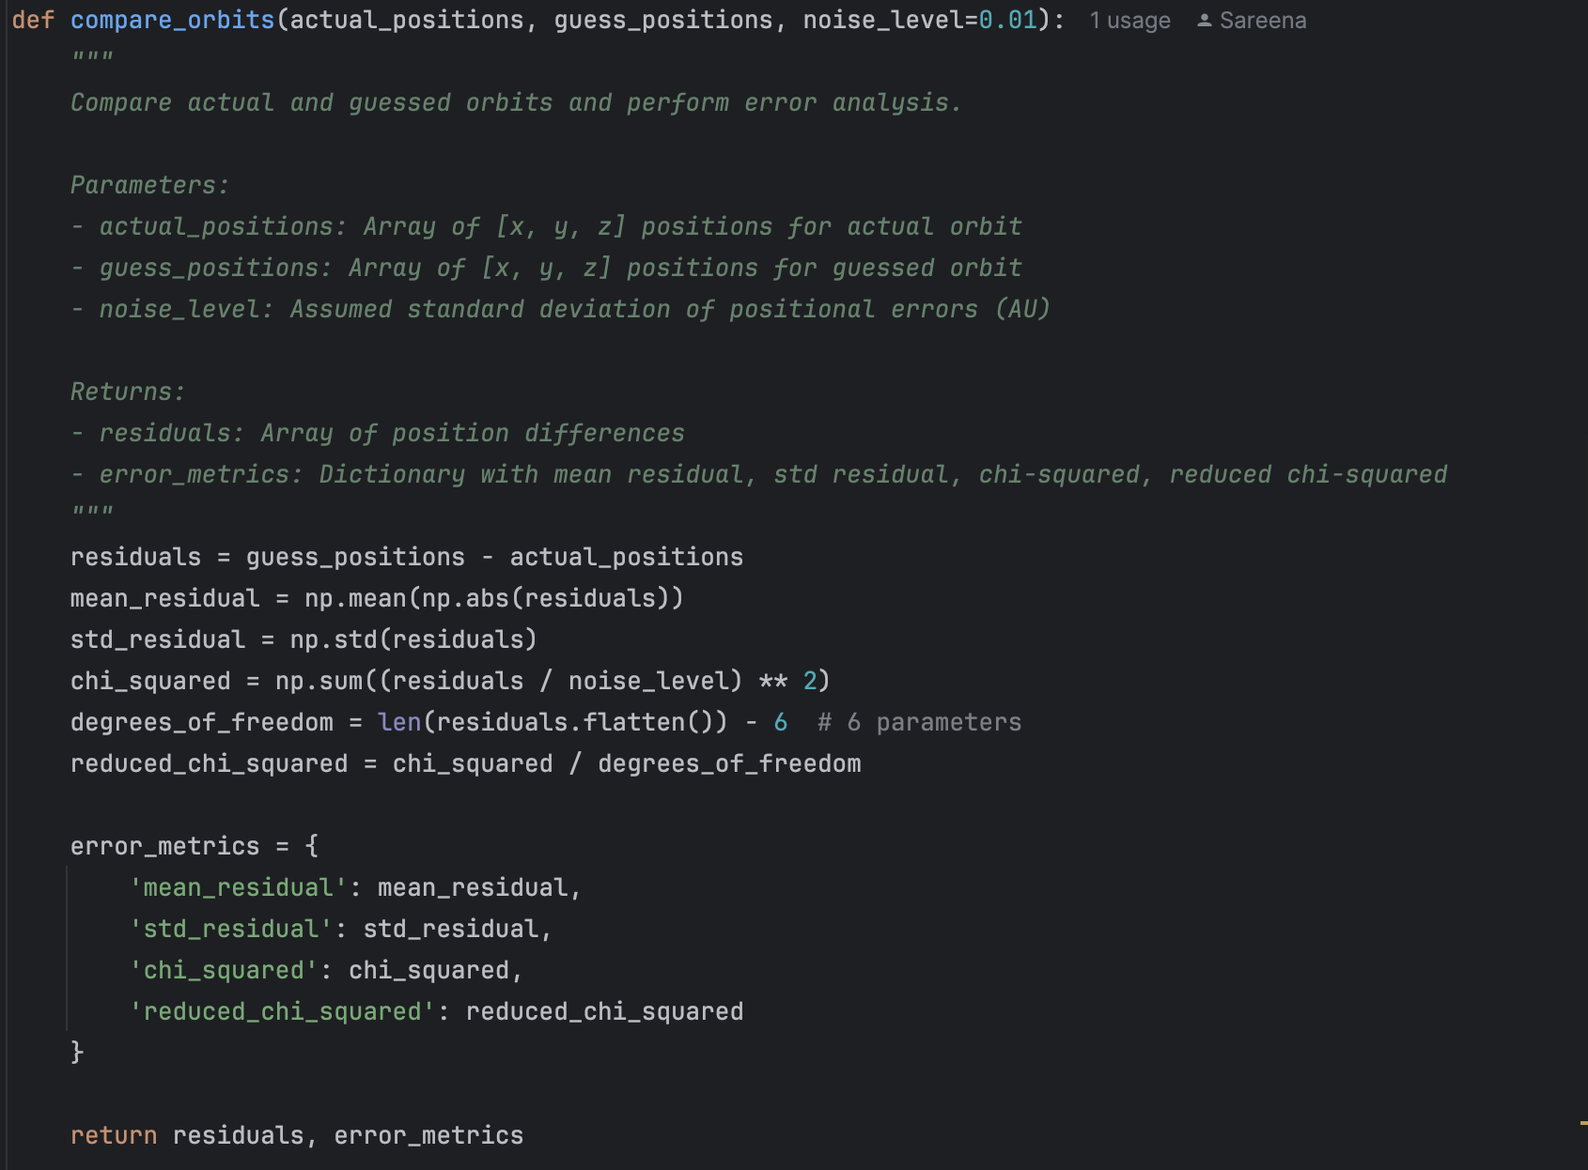
How it works
Works similar to the previous animation feature, except another “guessed” orbit by perturbing orbital elements.
Perturbs elements randomly (e.g., e_guess = e * (1 ± random)), ensuring valid values (e.g., e < 1, q > 0.01).
Then I graphed both orbits and compared them
Comparison: compare_orbits
For every AU time step:
A residual is plotted (outputted graph)
Summary of the actual v guessed parameter
Summary of the chi square, std residual, mean residual, etc between the two

Slide 11

Github

Slide 12
Demo

